Slide 1
Morehouse School of Medicine
Hugh Gloster Building 1st & 2nd Floors Renovation
Move Meeting
March 28, 2017

Slide 2
Agenda
Introduction
Layout of Renovated Space
Timeline
Move
Issues and Topics
Questions and Answers

Slide 3
Introduction
Progress to Date
Contractor Finalized
Construction Transition Committee
    Purpose:
    To explore all aspects of the Hugh Gloster (HG) 1st and 2nd floor renovations and discuss the impacts, issues, and decisions regarding daily operations until project is complete.
    Beginning February 2017, weekly meetings will be scheduled through the end of the project and additional meetings as needed.
Membership:
Ngozi Anachebe Assistant Dean, Admissions & Student Affairs
Torey Bradley Interim CIO & Director of Network Infrastructure
Natasha Browner Director, Laboratory Services and Research Resources
John Case SVP for Operations & CFO
Tony Collier Director of Auxiliary Services
Martha Elks Senior Associate Dean, Educational Affairs
John Fueredi Senior Associate, LEED AP (Lord, Aeck, Sargent)
Sandra Harris-Hooker Executive Vice Dean
Kendra Ivy Doctor of Medicine Candidate 2020
Larry Jones Director of Facilities (Sodexo)
Deborah Lyn Assistant Dean for Admissions and Student Affairs
Katherine Napier VP for Finance/Controller
Pamela Simmons VP, Marketing & Communications
https://dpr.app.box.com/s/uysuht96dv43blo714mgi7qsnxhcdufy

Slide 4
Introduction
Membership:
Ngozi Anachebe Assistant Dean, Admissions & Student Affairs
Torey Bradley Interim CIO & Director of Network Infrastructure
Natasha Browner Director, Laboratory Services and Research Resources
John Case SVP for Operations & CFO
Tony Collier Director of Auxiliary Services
Martha Elks Senior Associate Dean, Educational Affairs
John Fueredi Senior Associate, LEED AP (Lord, Aeck, Sargent)
Sandra Harris-Hooker Executive Vice Dean
Kendra Ivy Doctor of Medicine Candidate 2020
Larry Jones Director of Facilities
Deborah Lyn Assistant Dean for Admissions and Student Affairs
Katherine Napier VP for Finance and Strategic Financial Planning
Brian Oliver DPR
Pamela Simmons VP, Marketing & Communications

Slide 5
Introduction
Overview of Project and Phases (by DPR)
https://dpr.app.box.com/s/uysuht96dv43blo714mgi7qsnxhcdufy

Slide 6
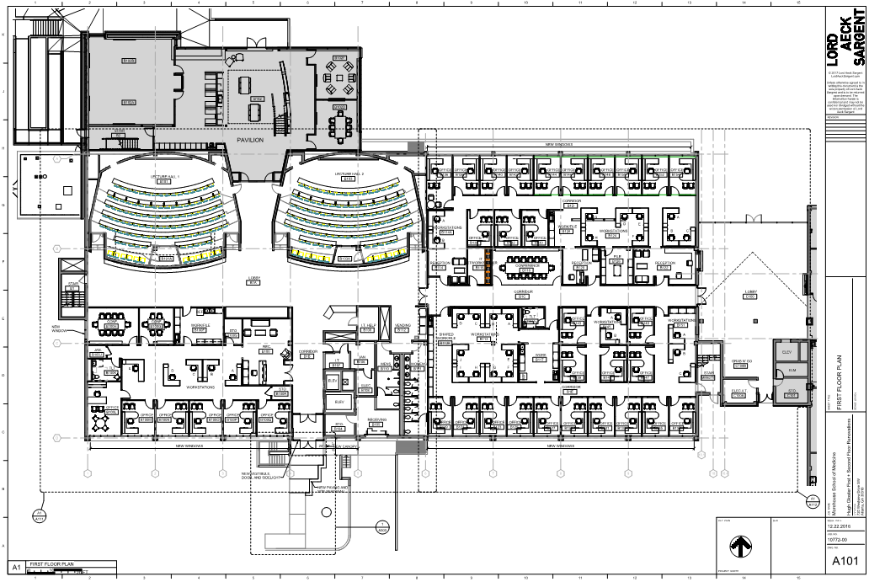

Slide 7
Student
Fiscal
Affairs
Student Affairs
Registrar
Admissions
GEBS
Executive
Vice Dean
Educational
Outreach
And Health
Careers
PA
MPH
Office of
Educational
Affairs

Slide 8
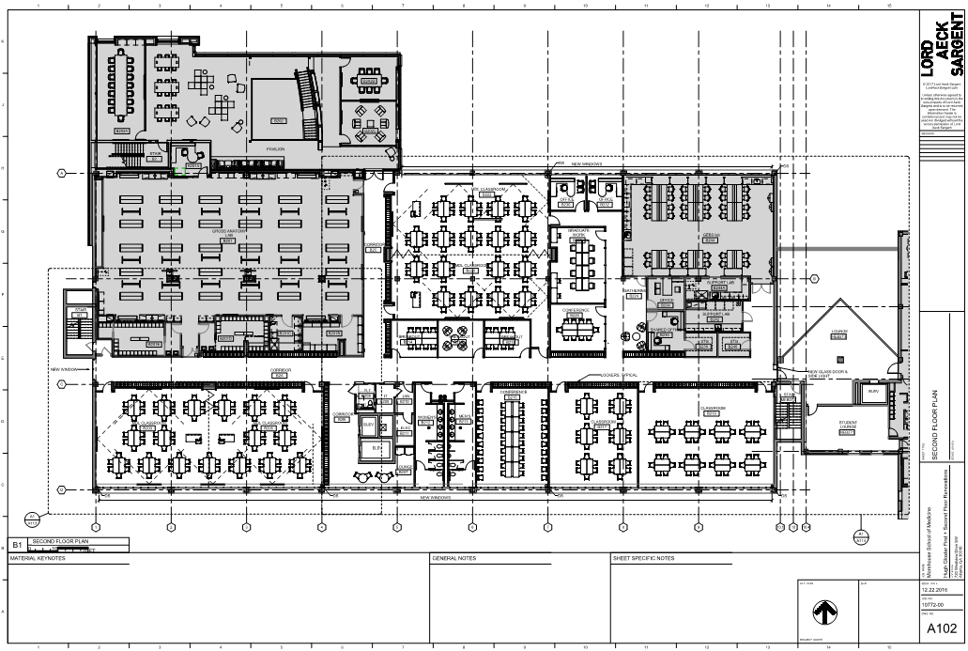

Slide 9
Overall Project Timeline

Slide 11
Move Timeline
Units affected:
Admissions
Curriculum Coordinators
Department of Medical Education
Educational Technology
Executive Vice Dean
Financial Aid
Graduate Studies
Institutional Review Board
Media
Office for Educational Outreach and Health Careers
Registrar
Sponsored Research
Tech Bar
Undergrad Medical Education

Slide 17
Issues & Topics Under Development
Crossing Lee Street
Contract / Pricing Finalization
Communications
  Weekly as needed
  Open Forums
  Sharepoint site
Other

Slide 18
Questions & Answers

