Slide 1
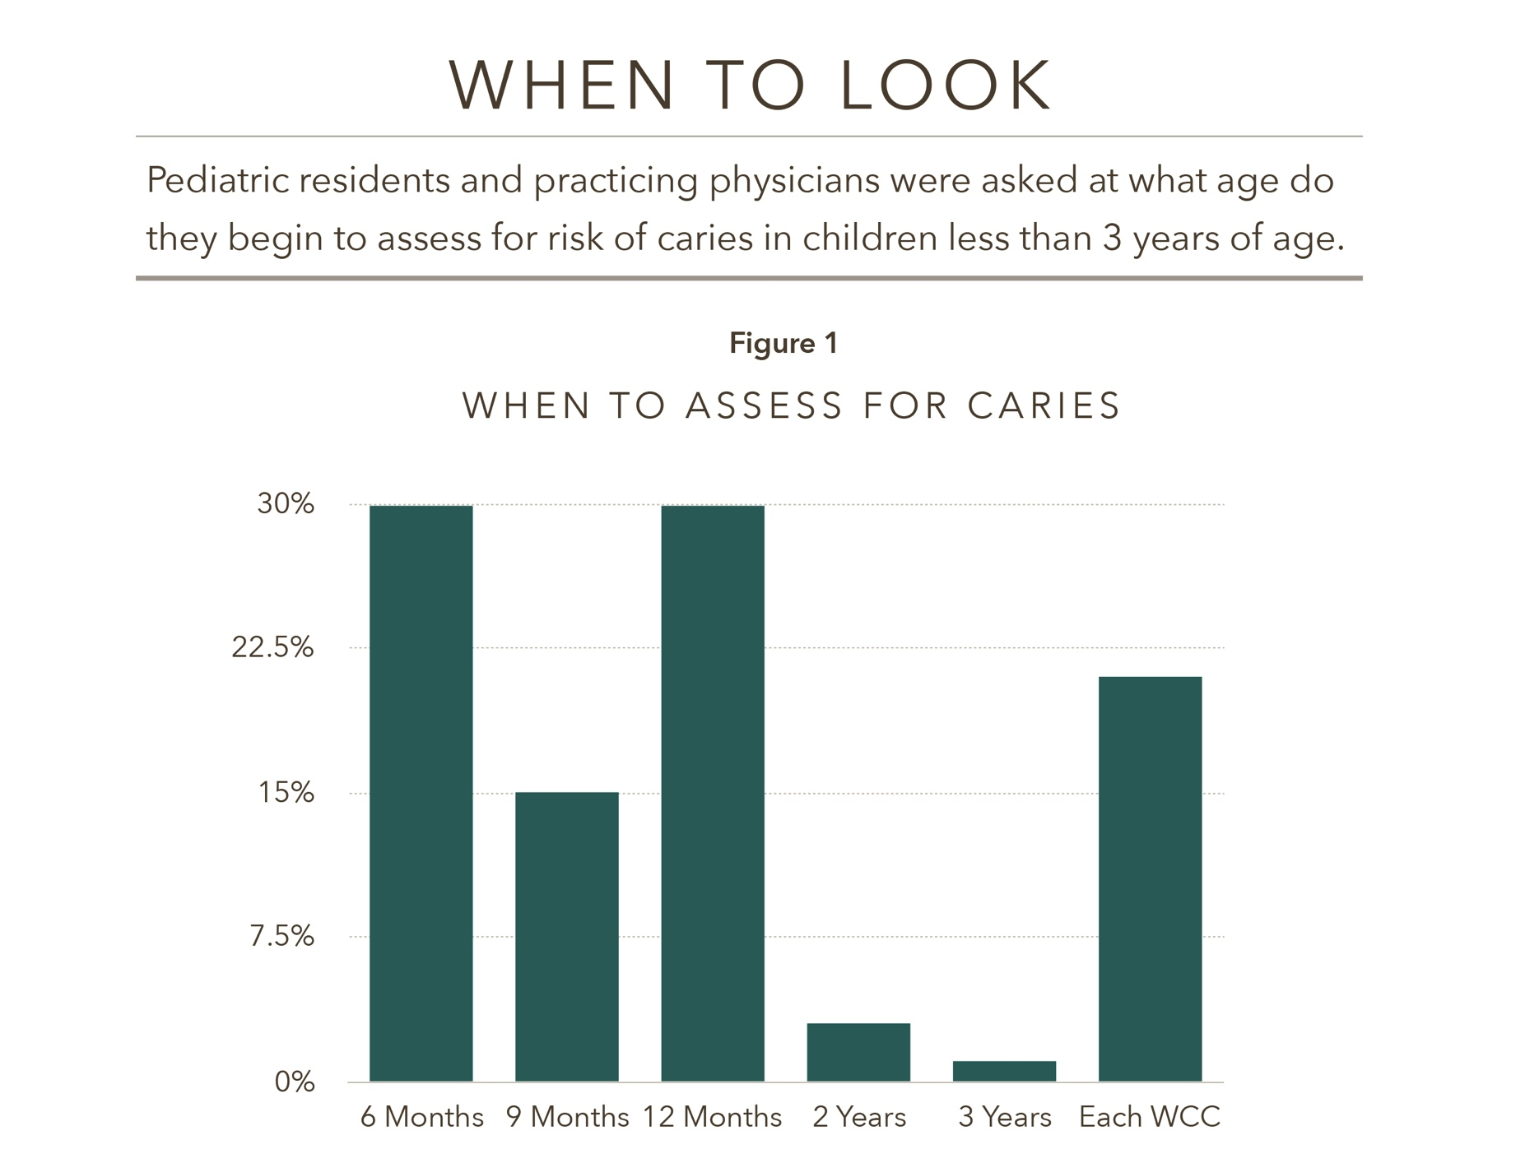
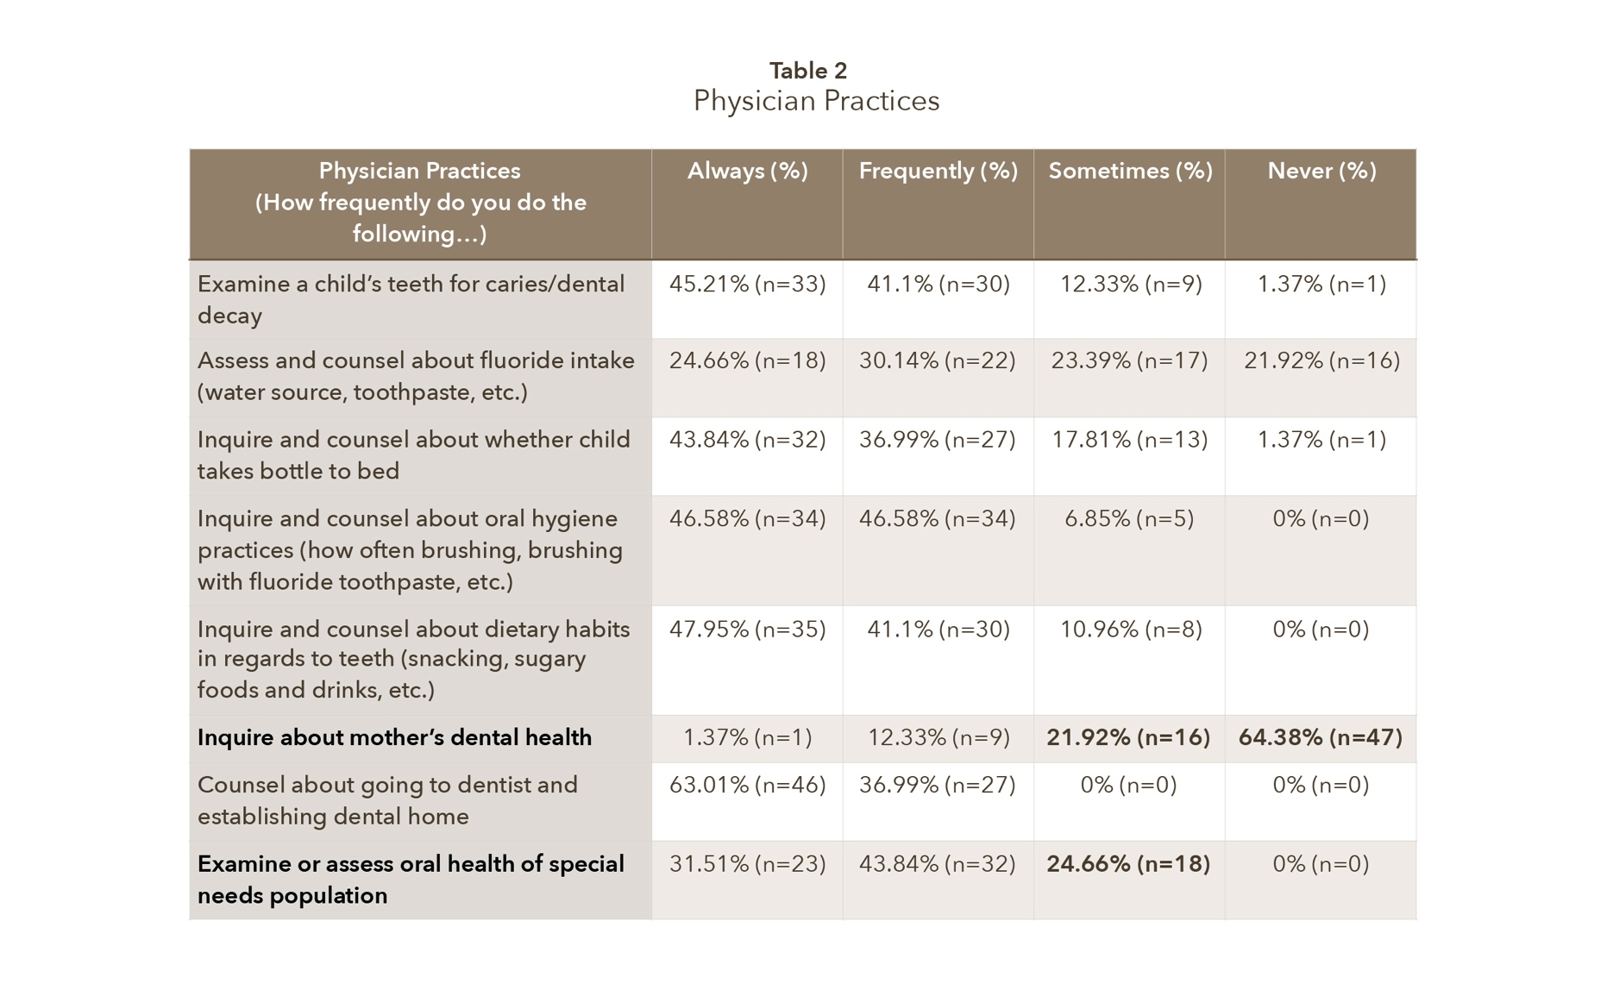
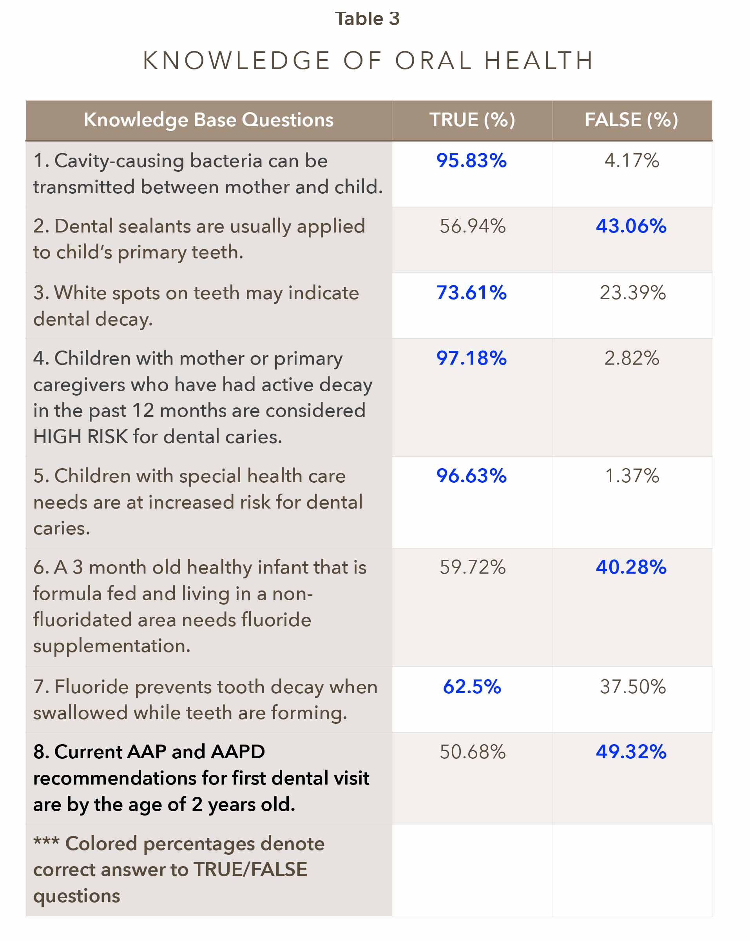
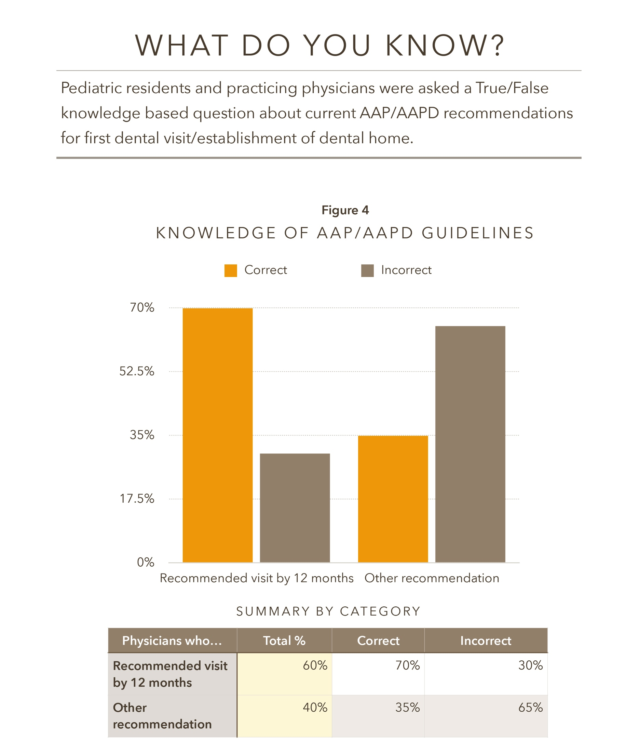
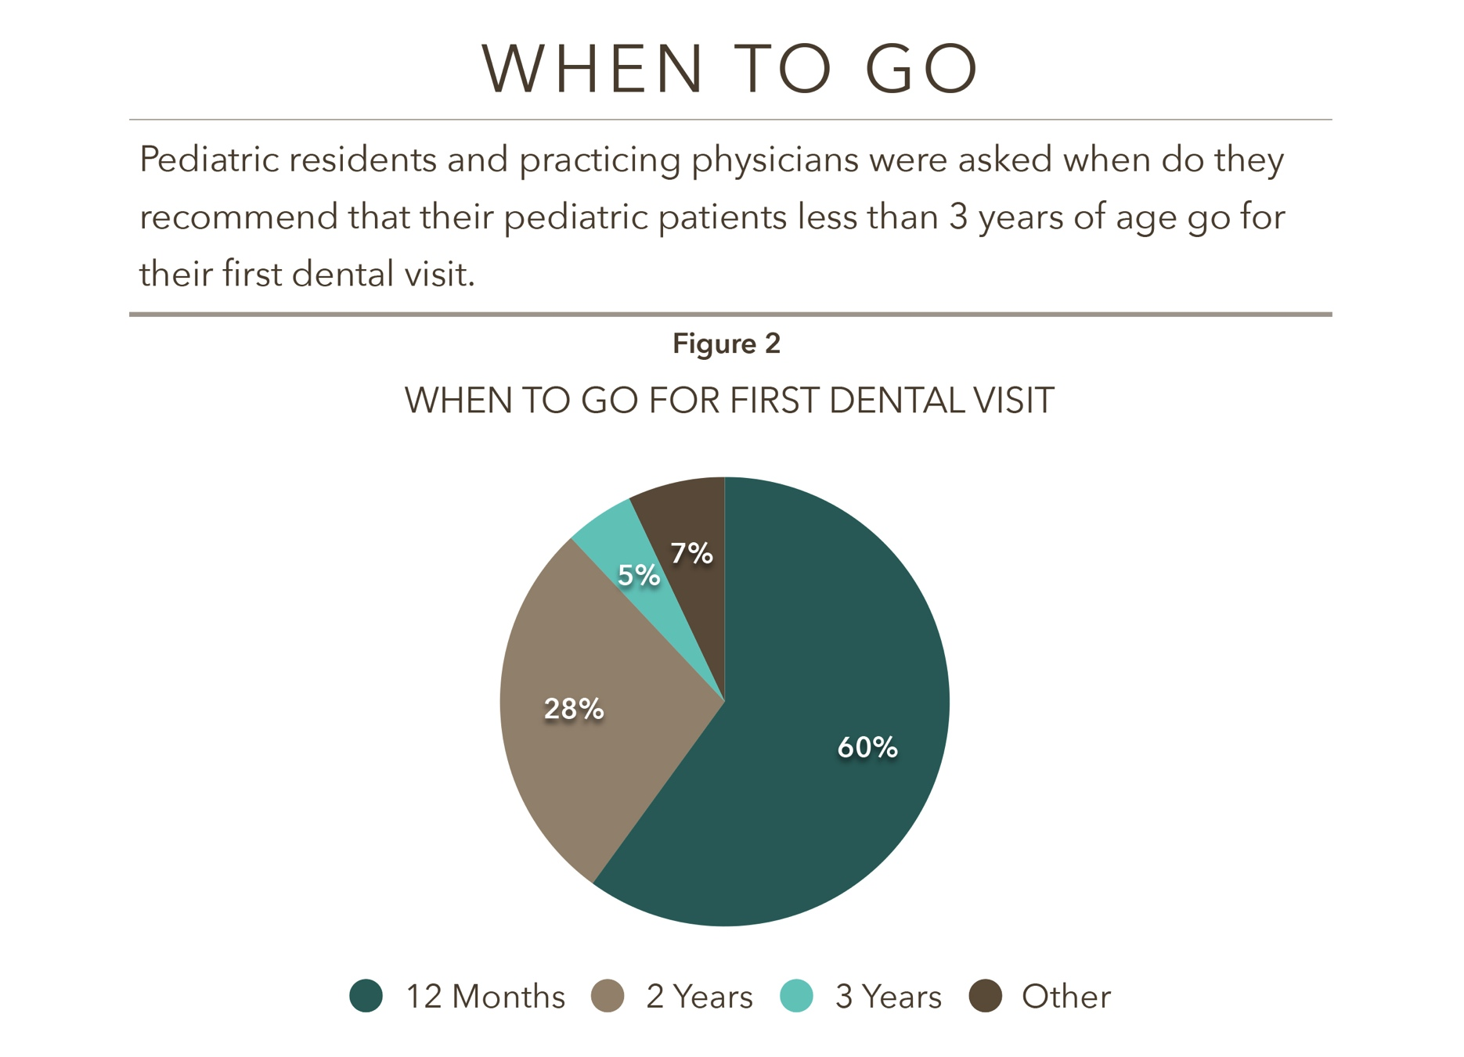
Pediatric Oral Health Assessment: Physician Practices, Knowledge, and Perceived Barriers
Rashida Allen Avery, MD, Amaris Evans Daniels, MD and Sandra Moore, MD
Morehouse School of Medicine
BACKGROUND
RESULTS
CONCLUSION
According to the Center for Disease Control and Prevention, early childhood caries (ECC) is one of the most chronic, yet preventable, childhood disease in the United States (5). Poor oral health puts individuals at risk for experiencing the physical, economic, and psychological disabilities that come as a result of poor dentition and undetected caries, as well as significant morbidity in adulthood. However, because ECC is a preventable disease, early intervention becomes key to improving and ensuring adequate oral health. The American Academy of Pediatric Dentistry (AAPD) has adopted the idea of early establishment of a dental home since 1986 and current recommendations state that infants and toddlers should be seen for their first dental visit within 6 months of the first tooth eruption or by no later than 12 months old⁽¹⁾. The American Academy of Pediatrics (AAP) has released several policy statements in agreement with the AAPD’s current recommendations. Despite the recommendations, there is lack of adherence and significant delays in first dental visits ⁽²⁾. It is known that a culmination of risk factors, such as socioeconomic status and race/ethnicity, are potential barriers to care for many children and families. However, less is known about the challenges that pediatricians face when providing and promoting oral health.
A total of 73 completed surveys were collected, with 27% of responses by pediatric resident physicians, 70% by practicing general pediatricians, and 3% by pediatricians who specified “other” (i.e. retired).
Our study showed that while the majority of general pediatricians and pediatric residents are examining pediatric patient’s teeth for caries, there are still discrepancies in knowing what risk factors to assess for, when to begin oral health risk assessments, and current recommendations per AAP/AAPD regarding first dental visit and early establishment of a dental home. Standardized implementation of a formal oral health risk assessment tool, such as the one developed by the AAP, would provide pediatricians with a quick and easy descriptive way to remember 1.) when and at which visits to conduct oral risk assessments 2.) which risk factors to assess for and what clinical findings to document 3.) appropriate anticipatory guidance to deliver based on risk and 4.) when to refer to a dentist. By adapting this tool, pediatricians could have a relatively significant impact on infant and toddler oral health outcomes and overall quality of life.
Pediatric physicians can play a role in the prevention of caries and limit barriers to care by partnering with others in the community, especially general and pediatric dentists, to set up creative solutions to address access to dental care among our pediatric population, especially those with public or no insurance at all.
Majority of respondents report examining a child’s teeth for caries.
62% of respondents do not use an oral health risk assessment tool to assess for risk of caries in their pediatric patients.
Only 30% of respondents correctly identified correct age at which to begin to assess for risk of caries.
64% of respondents reported “never” asking mother about her dental health.
PURPOSE
The purpose of this study is to assess general pediatricians and pediatric residents for the following: 1) Current oral health practices, initiatives and level of adherence to pediatric oral guidelines established by the AAP/AAPD. 2) Current knowledge and perceived level of confidence to oral healthcare and current guidelines as it pertains to children 0-3 years of age. 3) Perceived barriers to adhering to current oral health guidelines and making dental referrals.
Our goal is to provide insight on areas of improvement as it pertains to early establishment of a dental home and better promotion and provision of oral health practices in our young pediatric population.
REFERENCES
American Academy of Pediatric Dentistry. Infant oral health. Pediatric Dent. 2000;22:47–48
Yu SM, Bellamy HA, Kogan MD, Dunbar JL, Schwalberg RH, Schuster MA. Factors that influence receipt of recommended preventive pediatric health and dental care. Pediatrics. 2002;110(6). Available at: www.pediatrics.org/cgi/content/full/110/6/e73
Edelstein, B.L. Disparities in oral health and access to care: findings of national surveys. Ambul Pediatric. 2002; 2: 141–147
Crall JJ, Krol DM, Lee JY, et al. Policy Statement. Preventive oral health intervention for pediatricians. Pediatrics. 2008;122:1387–1394.
www.cdc.gov/oralhealth/children_adults/child.htm
METHODS
This was a cross sectional research study. Our targeted population was Georgia practicing general pediatricians and pediatric resident physicians from Morehouse School of Medicine, Emory School of Medicine, and members of the Ga Chapter of AAP. A survey was distributed that consisted of 48 items inclusive of demographic information and questions to assess current physician practices related to oral health, knowledge base and perceived confidence level with oral health topics, and perceived barriers to promotion of oral health.
60% of pediatricians correctly recommend first dental visit by 12 months of age.
When knowledge of current AAP/AAPD guidelines regarding oral health and first dental visit were assessed (Table 3, question 8), only 49% answered correctly.
Of the respondents who incorrectly identified the recommended age for the first dental visit, 35 % correctly acknowledged the AAP/AAPD guideline; This particular population was noted to have been practicing for 15 years or longer.
Most respondents sited the following as potential barriers: type of or lack of insurance, lack of dentist who will see 6 month-1 year olds, parental factors, and time constraints. For referrals, most respondents inform the parent or provide parents with dentist contact information

