Slide 1
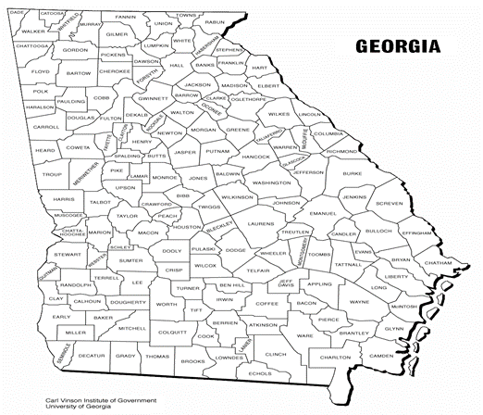


Identifying the Current Perspectives and Knowledge of Contraceptive Management, Specifically Long Acting Reversible Contraceptives, Among Adolescent Healthcare Providers in the State of Georgia
Roxanne Samuels MD, Nicole Davidson MD, David Levine MD
Introduction
Results
Table 1: Please indicate how much you agree with these statements?
Graph 1
 | Disagree/Strongly Disagree | Neutral | Strongly Agree/Agree
Adolescent and young women would not be interested in IUDs or Implants | 77.4% | 16.1% | 6.5%
Adolescent and young women would want the IUD or implant removed if I put it in | 40.9% | 44.26% | 14.76%
Adolescent and young women who use IUDs or implants are more likely to have sex without a condom | 37.7% | 24.59% | 37.72%
You can use an IUD in a woman who has not been pregnant | 14.52% | 3.23% | 82.26%
You cannot use an IUD in a woman who has had an STD | 75.8% | 12.09% | 11.29%
I don’t talk about IUDs and Implants with adolescent and young women because I don’t offer that service. | 47.54% | 11.48% | 40.9%
I don’t think IUDs and implants are appropriate for adolescent and young women. | 75.8% | 14.52% | 9.68%
I let my personal beliefs guide the information I provide my patients | 16.39% | 16.39% | 45.9%
Teenage pregnancy has become a common occurrence across the United States. Georgia is currently ranked 12th in the nation for teenage pregnancy rates.²
Compared to other methods of contraception (condoms, withdrawal, oral contraceptives), Long Acting Reversible Contraceptives (LARCs) including contraceptive implants and intrauterine devices, have proven to be the most effective in preventing adolescent pregnancy.⁴
The goal of this research is to gather information on the perspectives and knowledge of Pediatric primary care providers who see adolescents regarding contraceptive counseling, community resources, and the utilization of LARCs or other forms of contraception.
Of the 1400 available email recipients, 65 responded to the survey.
78% self-identified as an Attending, 10% residents, and 4.5% were nurse practitioners, physician assistants or nurses.
Approximately 47% had >15years of experience, 20% with 11-15yrs experience, 10% with 6-10years experience, and the remaining 22% had 5 years or less of pediatric practice experience.
23 of the 65 responses were from Fulton county.
41 of the 65 responses came from the metro-Atlanta area (Fulton, Dekalb, Cobb, and Gwinnett Counties).
Figure 1⁷
Discussion
We concluded that most pediatric providers in Georgia do discuss contraception, but there are still many providers who are uncomfortable with LARC placement, LARC management and who desire more education and referral resources for themselves, patients and parents. There was also a small subset of providers who did not feel comfortable recommending LARCs to teens at all and were not familiar with the most updated guidelines for usage. One of the limitations to the study included a low number of survey responders, possibly due to physician survey fatigue.
Table 2: How helpful would the following information be in helping to facilitate adolescent and young women in your area having increased access to LARCs?
Methods
 | Not at all/Not very helpful | Neither | Somewhat/Very helpful
Confidentiality for contraception for teens | 4.84% | 8.05% | 87.09%
Billing and coding | 13.34% | 18.33% | 68.33%
Provider training for implant placement | 25.81% | 14.52% | 59.68%
Provider training for IUD placement | 29.03% | 20.97% | 50%
Problem management for LARCs | 14.51% | 12.90% | 72.59%
Contraceptive counseling | 9.68% | 12.9% | 77.42%
Non-provider staff education on LARCs | 22.58% | 17.74% | 59.67%
Administrative and managerial education on LARCs | 27.87% | 16.39% | 55.74%
Knowledge and awareness-raising | 6.56% | 8.2% | 84.43%
Parent education | 6.56% | 4.92% | 88.53%
Local referral resources | 6.6% | 5% | 88.33%
A survey of 16 questions was distributed to the members of the Georgia Chapter of the American Academy of Pediatrics by email.
The survey was available from June to August 2014. Responses were anonymous.
Conclusion
Most healthcare providers discussed Condoms (67%), Oral Contraceptives (49%) and Abstinence (68%) with their female patients aged 11-21yrs old.
This was a significant difference in comparison to those who discussed LARCs with the same age group; 17% for a contraceptive implant and 11% for intrauterine devices.
Less than 5% of the health providers felt comfortable placing IUD and more than 80% were not interested in receiving training if offered.
There was a minority of providers (12-15%) who incorrectly thought IUDs could not be used in a woman not previously pregnant or with a history of sexually transmitted infections.
The use of LARCs and pregnancy rates in Georgia will mostly be influenced by both teens and providers having a greater understanding and knowledge about the use of LARCs as well as putting interventions in place to address the barriers to care.
Resources
Survey participants were asked their preferred method to receive more contraceptive education. The majority (64.71%) indicated a CME certified seminar would be the most effective, and appealing method to retrieve information. Additional forms include Educating Physicians in Communities (EPIC), 49.02%, and Webinars at 37.25%.
1. Eaton DK, Kann L, Kinchen S, et al. Centers for Disease Control and Prevention (CDC). Youth risk behavior surveillance - United States, 2011. MMWR Surveillance Summary. 2012; 61(4):1–162
2. The National Campaign to Prevent Teen and Unplanned Pregnancy. www.thenationalcampaign.org
3. www.gcapp.org/fast-facts
4. Ott, MA and Sucato, GS. Policy Statement: Contraception for Adolescents. American Academy of Pediatrics. 2014.
5. Few teens use the most effective types of birth control. Center for Disease Control. April 7, 2015.
6. Branum, AM and Jones J. Trends in Long-acting reversible contraception use among U.S. women aged 25-44. US Department of Heath and Human Service. NCHS Data Brief. No. 188. February 2015.
7. www.georgiainfo.galileo.usg.edu

