Slide 1
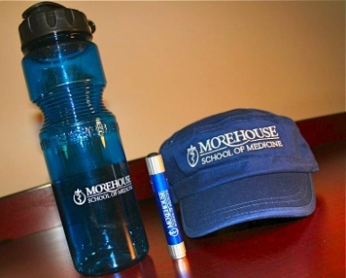
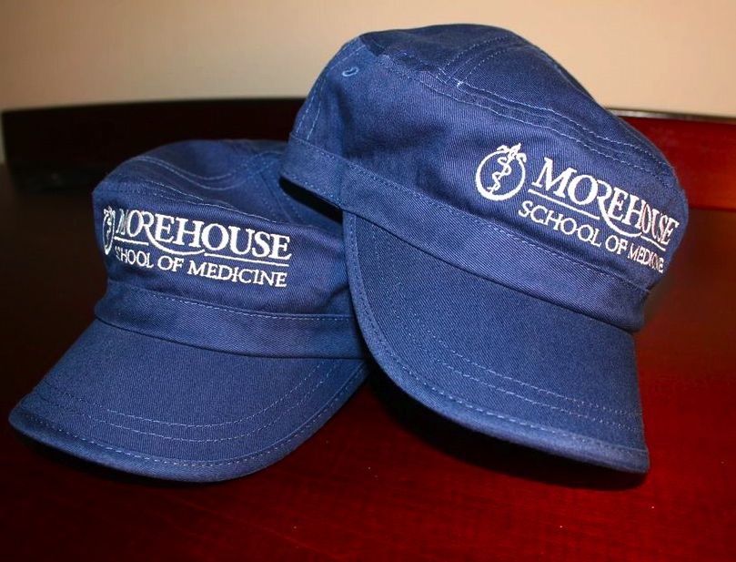
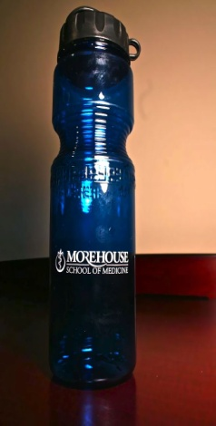
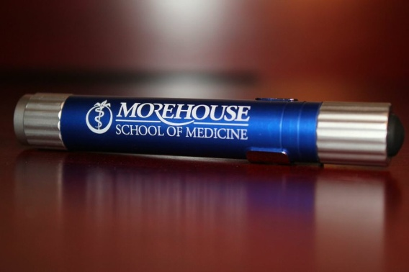
Great gifts for Family & Friends!
Class of 2015 Fundraiser
$5
$15
$8
Don’t get caught in clinic without a pen light!
Water Bottles are great for staying hydrated!
No more bad hair days!
All proceeds are donated to the Class Gift. Email lgobin@msm.edu with orders

