Slide 1
Hallmarks of HIV Pathogenesis are Modulated by Nef’s Secretion Modification Region
Seminar Outline:
The “Southern Epidemic”: Atlanta in the crosshairs.
  The response to the epidemic in Fulton County
HIV Research at MSM
Nef Pathogenesis Group research contributions
  Background and Model
  Tools developed: Analysis of mutant viruses in culture
  In vivo Model - data

Slide 2
We have effective tools and knowledge to end AIDS - this process has started in US and even globally
I. The “Southern Epidemic”
Bellevue Hospital in New York City closed its AIDS ward in June 2012.
New HIV infections in South Africa decreased 58% between 2009 and 2014 [UNAIDS, 2015].
Cuba eliminated mother-to-child HIV transmission in 2015 [WHO, 2015].
Even the District of Columbia (DC), America’s most HIV-affected jurisdiction, decreased its HIV diagnoses by 57% over eight years [DC DOH, 2015].
Globally, and even in highly affected American cities like San Francisco, there are goals of “Getting to Zero,” meaning zero AIDS deaths, zero new HIV infections, and zero discrimination [SF Zero, 2015].
The White House tells us an “AIDS-free Generation” is within our reach [White House, 2011]. The world around us has changed in remarkable ways with the advent of potent and tolerable drugs to treat and prevent HIV, and the discovery that effective treatment of HIV not only saves lives and keeps people healthy, but also sharply decreases HIV transmission to others.
Additionally, in 2012, a medication to prevent HIV infection(PrEP) was licensed by the Food and Drug Administration (FDA). US cities, states, and countries that have benefitted most from these advances are those that have had the political will to use their knowledge and resources to change the course of the HIV/AIDS epidemic.

Slide 3
HOWEVER:
The Southern United States continues to face great challenges which have affected the epidemic.
The greatest poverty,
The highest rates of sexually transmitted infections (STIs),
The greatest number of people without health insurance,
The least access to health care,
The South has the most people (US) living with HIV and AIDS,
The highest HIV/AIDS-related mortality rates,
The fastest growing epidemic in the nation.

Slide 4
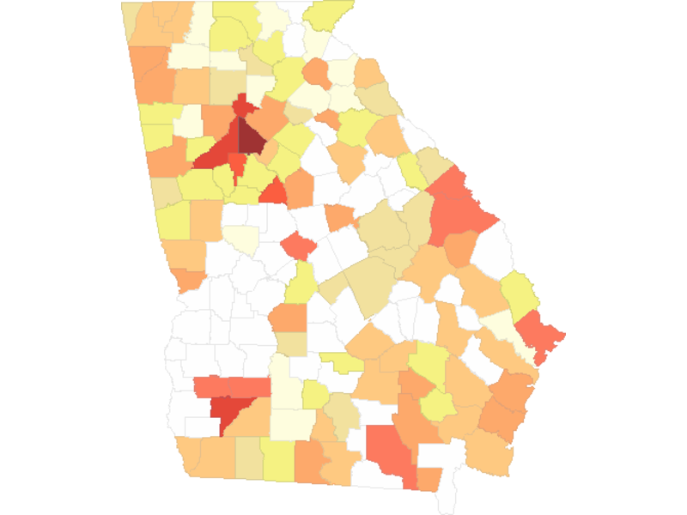
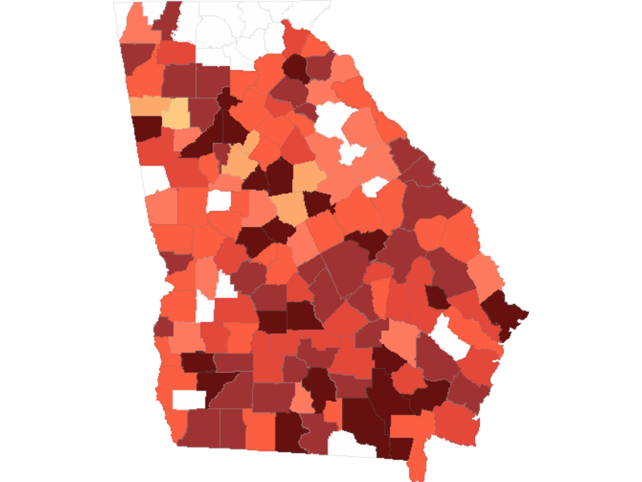
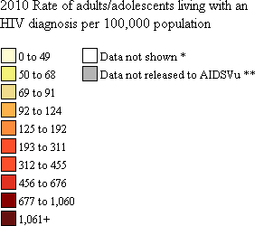
Rates of White Persons Living with an
HIV Diagnosis in Georgia, by County, 2010
Health Disparity
Health Disparity
Rates of Black Persons Living with an
HIV Diagnosis in Georgia, by County, 2010
* Data are not shown to protect privacy. ** State health department requested not to release data.
* Data are not shown to protect privacy. ** State health department requested not to release data.
Note. Data include persons with a diagnosis of HIV infection, regardless of the stage of disease at diagnosis, and have been statistically adjusted to account for reporting delays and missing risk-factor information, but not for incomplete reporting.
Data Source: Centers for Disease Control and Prevention, National Center for HIV/AIDS, Viral Hepatitis, STD, and TB Prevention, Division of HIV/AIDS Prevention.
Note. Data include persons with a diagnosis of HIV infection, regardless of the stage of disease at diagnosis, and have been statistically adjusted to account for reporting delays and missing risk-factor information, but not for incomplete reporting.
Data Source: Centers for Disease Control and Prevention, National Center for HIV/AIDS, Viral Hepatitis, STD, and TB Prevention, Division of HIV/AIDS Prevention.
http://www.aidsvu.org
http://www.aidsvu.org
Notes:
Rates of White Persons Living with an HIV Diagnosis, by County, Georgia, 2010
This map shows the estimated county-level rates (per 100,000 population) of white adults and adolescents living with an HIV diagnosis in Georgia at the end of 2010.
Data include adults and adolescents living with a diagnosis of HIV infection, regardless of the stage of disease at diagnosis, and have been statistically adjusted to account for reporting delays and missing risk-factor information, but not for incomplete reporting. All displayed data are estimates based upon actual data reported to CDC through June 2012.
Persons living with an HIV diagnosis are classified as adult or adolescent based on age at end of 2010.
Data were released to AIDSVu in accordance with the state health departments HIV surveillance data re-release agreement with CDC.
More information about AIDSVu's data methods and sources can be found at www.aidsvu.org.

Slide 5
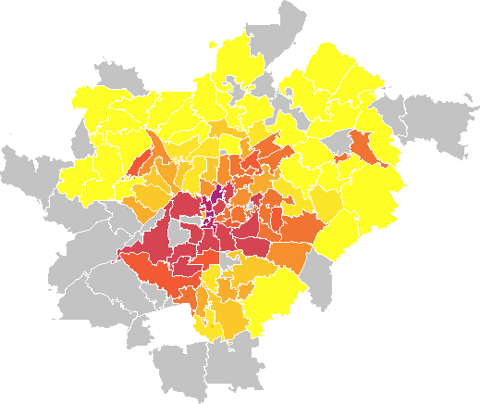
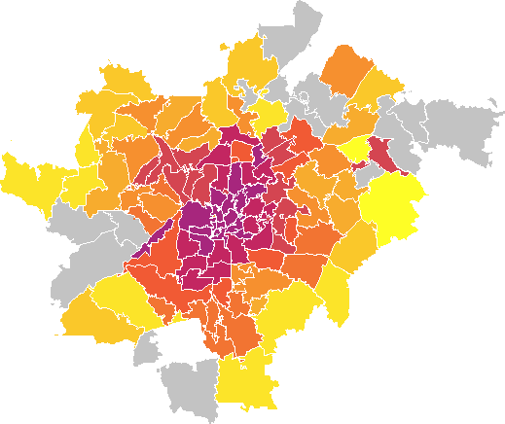
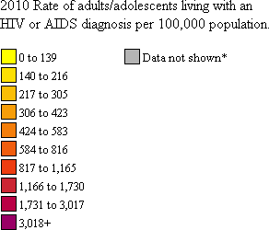
Health Disparity
Health Disparity
Rates of White Persons Living with an HIV or AIDS Diagnosis in Atlanta, by ZIP Code, 2010
Rates of Black Persons Living with an HIV or AIDS Diagnosis in Atlanta, by ZIP Code, 2010
* Data are not shown to protect privacy because of a small number of cases and/or a small population size.
* Data are not shown to protect privacy because of a small number of cases and/or a small population size.
Notes. Rates include persons living with an HIV or AIDS diagnosis in Clayton, Cobb, DeKalb, Fulton, and Gwinnett Counties at the end of 2010 and who were reported as of 04/01/2013. Data have not been adjusted for reporting delays.
Data Source: Georgia Department of Public Health, Division of Health Protection, Epidemiology Program, HIV/AIDS Epidemiology Section.
Notes. Rates include persons living with an HIV or AIDS diagnosis in Clayton, Cobb, DeKalb, Fulton, and Gwinnett Counties at the end of 2010 and who were reported as of 04/01/2013. Data have not been adjusted for reporting delays.
Data Source: Georgia Department of Public Health, Division of Health Protection, Epidemiology Program, HIV/AIDS Epidemiology Section.
Notes:
Rates of White Persons Living with an HIV or AIDS Diagnosis, by ZIP Code, Atlanta, 2010
This map shows the reported ZIP-code-level rates (per 100,000 population) of white persons living with an HIV or AIDS diagnosis in Atlanta at the end of 2010.
Data reflect cases reported through 04/01/2013 and are based on residence at diagnosis as reported in Georgia's Electronic HIV/AIDS Reporting System (eHARS). Data reflect cases from ZIP codes in Clayton, Cobb, DeKalb, Fulton and Gwinnett Counties. Cases missing ZIP code at diagnosis are excluded from the analysis.
Persons living with an HIV or AIDS diagnosis are classified as adult or adolescent based on age at end of 2010.
More information about AIDSVu's data methods and sources can be found at www.aidsvu.org.

Slide 6
The “Southern Epidemic”
These statistics are fueled by uniqueness in the South’s cultural, political, and societal barriers which link to a number of underlying factors:
  the pervasive stigma surrounding HIV regionally
  leading to discrimination
  built in racial and ethnic disparities
  aggressive homophobia
  long lasting poor social determinants
So, “Half the epidemic is in the South.
  However the South is not getting half of the dollars available, nor are half of the people at the important tables that dole out these dollars from the south”

Slide 7
In the South - Georgia
Fulton County has become one of the epicenters of the HIV epidemic in America.
  Nationally, Georgia ranks second and Atlanta ranks fifth in our rate of new HIV diagnoses [CDC 2013 Surveillance Report].
In Fulton County, the steady rise in new diagnoses among young black gay and bisexual men has continued unabated over the last decade [Georgia DPH, unpublished].
As of 2014, there were about 15,101 persons living with HIV/AIDS in Fulton County.
Fulton accounts for about 45% of HIV cases in the 20 county Atlanta Eligible Metropolitan Area (EMA).
Metro Atlanta ranks ninth and 11th in deaths due to AIDS among men and women, respectively, even at a time when progression to AIDS is entirely preventable with antiretroviral therapy (ART) [CDC, April, 2015].
In 2014 alone, a testing program in the emergency department (ED) of Grady Memorial Hospital found that half of persons newly diagnosed with HIV already had advanced immune destruction and met the definition of having AIDS [Unpublished data].
“Downtown Atlanta is has rates similar to Zimbabwe or Harare or Durban” [2016]
This lack of diagnosis and treatment was unacceptable in the early days of the epidemic, but it is inexcusable in 2015.

Slide 8
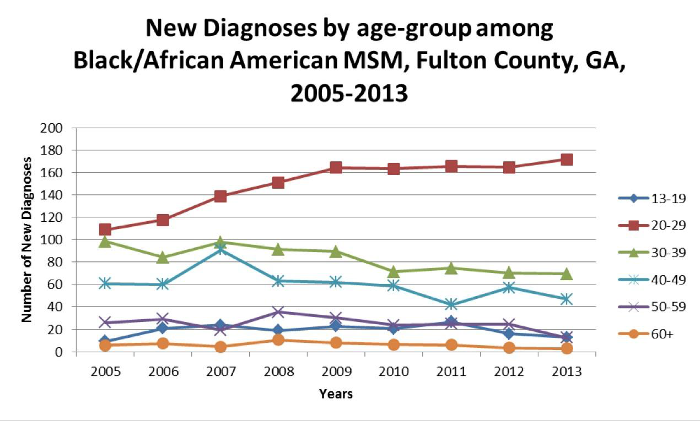
Group with half
the new infections
Notes:
Rising numbers of new HIV infections among Black men who have sex with men
(MSM}: Georgia Department of Public Health HIV Epidemiology Unit

Slide 9
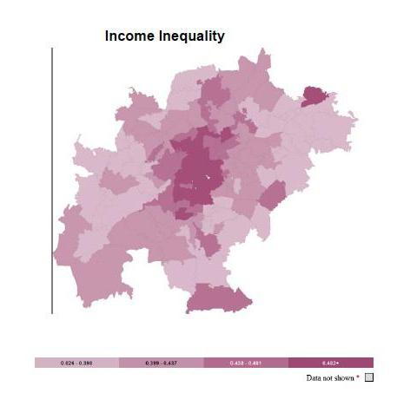
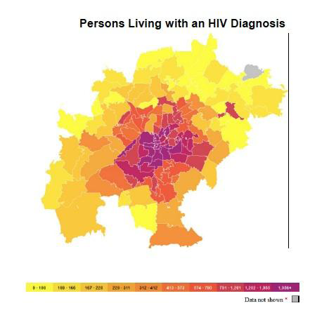
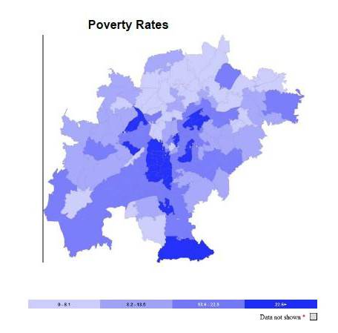
In the South - Georgia
HIV/AIDS “problem” does not exist in isolation. Metro Atlanta is first in the country, and Georgia is third, in primary and secondary syphilis.
Fulton is first in syphilis in Georgia and sixth in the US [CDC STD, 2015].
Our homeless shelters recently were the site of a tuberculosis (TB) outbreak, including drug-resistant TB, raising concerns at the local, state, and national levels.
Thirty to 50% of this outbreak occurred in HIV-positive persons who were not in care.
For persons with HIV, ART has been shown to lower greatly the risk of contracting TB.
Cases of HCV, spread by needles and unprotected sex, are on the increase.
And, like those affected by HIV, those with communicable diseases share similar health disparities and are affected by social determinants of health, such as poverty and income inequality, unstable housing, low educational attainment, lack of health insurance, unemployment, lack of food, poor transportation, and social attitudes that promote stigma and discrimination.
Maps of poverty and income inequality mirror those of HIV prevalence [AIDSVu, 2015].
Because social determinants like these are our greatest challenges, any plan that neglects these larger forces is doomed to fail.
Notes:
HCV - Hepatitis C Virus

Slide 10
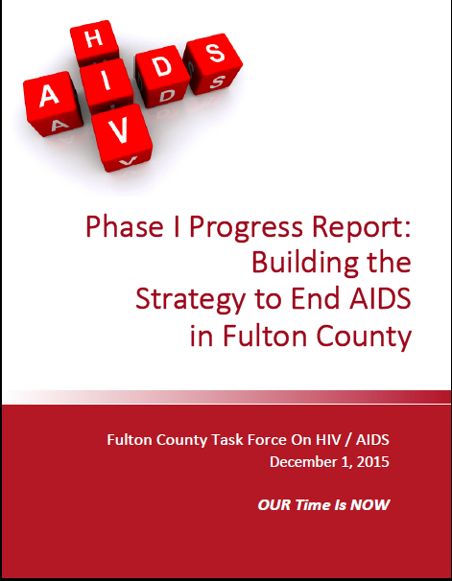
Solutions
Fulton County Task Force on HIV/AIDS
Ending this epidemic requires a community
-wide response. The Task Force was formed
to develop a Strategy to End AIDS in Fulton
County that would guide that response.
-Launched by Fulton County Commissioners in late 2014
-Contains many Stakeholders across the county
Phase I – Developed draft objectives

Slide 11
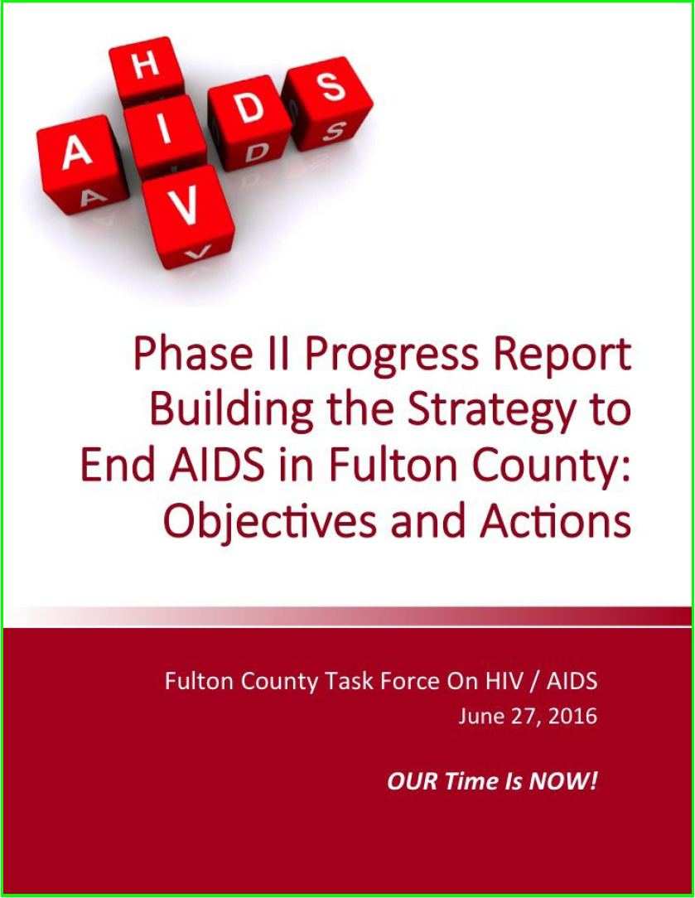
Phase II, involved in-depth stakeholder meetings
around ATL. Resulting in establishing specific
objectives and recommended actions for achieving
those objectives.
Phase II rolled out in late June, 2016.
Phase III, doing resource analysis and gap analysis
for the objectives and actions, including timelines
and annual targets, where appropriate.
Phase III will be rolled out on World AIDS Day
(December) 2016.
So, there is action ongoing to begin to address
this in Fulton County
Notes:
Phase I – Developing draft objectives
Phase II – Talking in-depth with stakeholders around ATL and establishing specific objectives and recommended actions for achieving the objectives.
Phase III – doing resource analysis and gap analysis for the objectives and actions, including timelines and annual targets, where appropriate. Phase III Strategy, including SMART
objectives and specific action plans with metrics and targets will be released in December 2016 in association with World AIDS Day.

Slide 12
II. HIV Research at MSM
Some highlights (non-exhaustive) of HIV projects and research teams

Slide 13



Did YOU know at MSM
Through the AIDS Education and Training Center (AETC) Educate all physicians, focusing on primary doctor physicians and care and treatment teams, on local HIV epidemiology, pre-exposure prophylaxis (PrEP) and treatment as prevention, and how best to talk about sex and HIV risks with patients. Goal is to raise health care community interest in taking immediate action to help thwart the drastic rise of new HIV infections
Dr Harold Stringer and Dr. Mesfin Fransua
Sean McIntosh, Program Manager

Slide 14

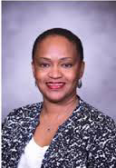

Did YOU know at MSM
That HIV Testing at Morehouse College/Clark Atlanta University is done through the TAKE Charge project funded by the Substance Abuse and Mental Health Services Administration (SAMSHA)?
we do HIV prevention work in the prison population?
we do HIV prevention work with adolescents in the community?
Dr Ron Braithwaite, Dr Rhonda Holiday, Dr Jean Bonhomme

Slide 15

Did YOU know at MSM
We are developing HIV Diagnostics and Therapies?
Noninvasive Urine Diagnostic – allows HIV infection detection;
allows monitoring of the effect of antiretroviral treatment
New Drug Class – Interferes with infected cell, locking HIV in the
cell and blocking effects of HIV that lead to AIDS
Plant-Based Herbal Treatment – Anti-viral properties that inhibit HIV and eliminate the infection
Dr VC Bond Dr Michael Powell Dr Gale Newman
Nef Pathogenesis Group

